Slide 1
Bryophytes General Characteristics
Class Teacher
Dr. Hannnan Mukhtar
Assistant Professor
Department of Botany
Lahore College for Women University, Lahore Pakistan.
Course Description
Course Title: DIVERSITY OF PLANTS
Course code: Min/Bot-102
Credit hours: 4 (3+1)
Class
Course : BS I, 2nd Semester
Major: Zoology
Minor course: Botany

Slide 2
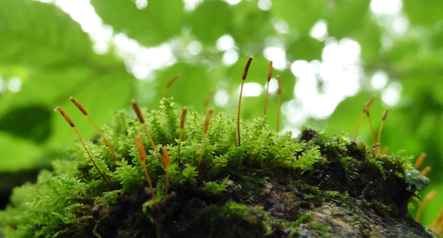

Slide 3
Introduction:
The division Bryophyta (Gr. bryon=moss) includes over 25000 species of non-vascular embryophytes such as mosses, liverworts and hornworts.
Bryophytes are small plants (2cm to 60cm) that grow in moist shady places. They don’t attain great heights because of absence of roots, vascular tissues, mechanical tissues and cuticle. They are terrestrial but require external water to complete their life cycle.
Hence, they are called “Amphibians of plant kingdom”.
The fossil record indicates that bryophytes evolved on earth about 395 – 430 million years ago (i.e. during Silurian period of Paleozoic era). The study of bryophytes is called bryology.
Hedwig is called ‘Father of Bryology’.
Source: http://www.biologydiscussion.com/bryophyta/bryophyta-features-classification-and-economic-importance/5654

Slide 4
Salient features of Bryophytes:
1. Bryophytes grow in damp and shady places.
2. They follow heterologous haplodiplobiontic type of life cycle.
3. The dominant plant body is gametophyte on which sporophyte is semiparasitic for its nutrition.
4. The thalloid gametophyte differentiated in to rhizoids, axis (stem) and leaves.
Vascular tissues (xylem and phloem) absent.
6. The gametophyte bears multi-cellular and jacketed sex organs (antheridia and archegonia).
7. Sexual reproduction is oogamous type.
8. Multi-cellular embryo develops inside archegonium.
9. Sporophyte differentiated into foot, seta and capsule.
10. Capsule produces haploid meiospores of similar types (homosporous).
11. Spore germinates into juvenile gametophyte called protonema.
12. Progressive sterilization of sporogenous tissue noticed from lower to higher bryophytes.
13. Bryophytes are classified under three classes: Hepaticae (Liverworts), Anthocerotae (Hornworts) and Musci (Mosses).
Source: http://www.biologydiscussion.com/bryophyta/bryophyta-features-classification-and-economic-importance/5654

Slide 5
Classification of Bryophytes:
According to the latest recommendations of ICBN (International Code of Botanical Nomenclature), bryophytes have been divided into three classes.
1. Hepaticae ( Hepaticopsida = Liverworts)
2. Anthocerotae (Anthocertopsida= Hornworts)
3. Musci (Bryopsida= Mosses)
Class 1. Hepaticae or Hepaticopsida:
1. Gametophytic plant body is either thalloid or foliose. If foliose, the lateral appendages (leaves) are without mid-rib. Always dorsiventral.
2. Rhizoids without septa.
3. Each cell in the thallus contains many chloroplasts; the chloroplasts are without pyrenoi.
4. Sex organs are embedded in the dorsal surface.
5. Sporophyte may be simple (e.g., Riccia) having only a capsule, or differentiated into root, seta and capsule (e.g., Marchantia, Pallia and Porella etc.)
6. Capsule lacks columella.

Slide 6
7. It has 4 orders:
(i) Calobryales
(ii) Jungermanniales
(iii) Spherocarpales
(iv) Marchantiales.
Source: http://www.biologydiscussion.com/bryophyta/bryophyta-features-classification-and-economic-importance/5654
A textbook of BOTANY, Paper-A---Diversity of Plants by Tanveer Ahmad Malik and Dr. Hammad Ashraf

Slide 7
Class 2. Anthocerotae or Anthocerotopsid:
1. Gametophytic plant body is simple, thalloid; thallus dorsiventra without air cambers, shows no internal differentiation of tissues.
2. Scales are absent in the thallus.
3. Each cell of the thallus possesses a single large chloroplast with a pyrenoid.
4. Sporophyte is cylindrical only partly dependent upon gametophyte for its nourishment. It is differentiated into bulbous foot and cylindrical capsule. Seta is meristematic.
5. Endothecium forms the sterile central column (i.e., columella) in the capsule (i.e. columella is present). 6. It has only one order-Anthocerotales.
Source: http://www.biologydiscussion.com/bryophyta/bryophyta-features-classification-and-economic-importance/5654

Slide 8
Class 3. Musci or Bryopsida:
1. Gametophyte is differentiated into prostrate protonema and an erect gametophores
2. Gametophore is foliose, differentiated into an axis (=stem) and lateral appendages like leaves but without midrib.
3. Rhizoids multi-cellular with oblique septa.
4. Elaters are absent in the capsule of sporangium.
5. The sex organs are produced in separate branches immersed in a group of leaves.
6. It has only three orders:
(i) Bryales,
(ii) Andriales and
(iii) Sphagnales.
Source: http://www.biologydiscussion.com/bryophyta/bryophyta-features-classification-and-economic-importance/5654

Slide 9
Sporophyte Characteristics of the three groups of Bryophytes
Source: https://byjus.com/biology/bryophyta/

Slide 10
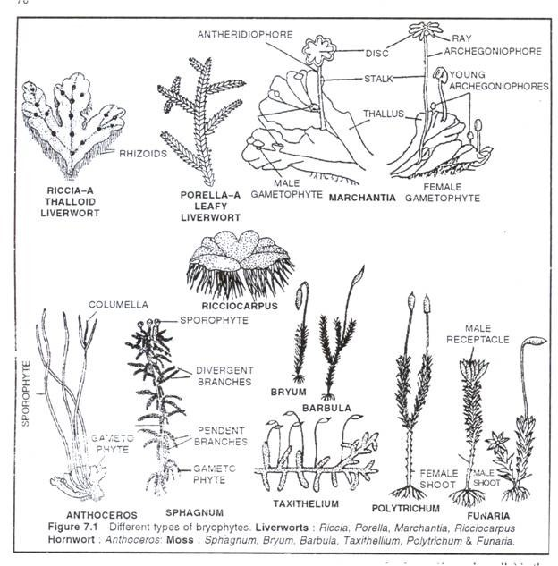

Slide 11
Economic importance of Bryophytes
1. Protection from soil erosion:
Bryophytes, especially mosses, form dense mats over the soil and prevent soil erosion by running water.
2. Soil formation:
Mosses are an important link in plant succession on rocky areas. They take part in binding soil in rock crevices formed by lichens. Growth of Sphagnum ultimately fills ponds and lakes with soil.
3. Water retention:
Sphagnum can retain 18-26 times more water than its weight. Hence, used by gardeners to protect desiccation of the seedling during transportation and used as nursery beds.
4. Peat:
It is a dark spongy fossilized matter of Sphagnum. Peat is dried and cut as cakes for use as fuel. Peat used as good manure. It overcomes soil alkalinity and increases its water retention as well as aeration. On distillation and fermentation yield many chemicals.
5. As food:
Mosses are good source of animal food in rocky and snow-clad areas.

Slide 12
6. Medicinal uses:
Decoction of Polytrichum commune is used to remove kidney and gall bladder stones. Decoction prepared by boiling Sphagnum in water for treatment of eye diseases. Marchantia polymorpha has been used to cure pulmonary tuberculosis.
7. Other uses:
Bryophytes arc used as packing material for fragile goods, glass wares etc. Some bryophytes act as indicator plants. For example, Tortell tortusa grow well on soil rich in lime.

Slide 13
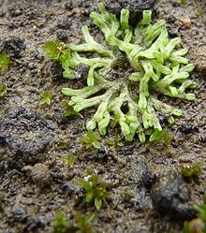
Riccia
Scientific classification
Kingdom: | Plantae
Division: | Marchantiophyta
Class: | Marchantiopsida
Order: | Marchantiales
Family: | Ricciaceae
Genus: | Riccia L., 1753
Riccia huebeneriana

Slide 14
Riccia is a genus of liverworts in the order Marchantiales (Schuster, 1992).
These plants are small and thalloid, that is not differentiated into root, stem and leaf. Depending on species, the thallus may be strap-shaped and about 0.5 to 4 mm wide with dichotomous branches or may form rosettes or hemirosettes up to 3 cm in diameter, that may be gregarious and form intricate mats (Schuster, 1992; Atherton et al., 2010).
The thallus is dorsiventrally differentiated. Its upper (dorsal) surface is green and chlorophyll-bearing, with a mid-dorsal longitudinal sulcus (furrow or groove). Air pores occasionally break through the dorsal surface, giving the thallus a dimpled appearance. In exceptional members such as Riccia caroliniana (Na-Thalang, 1980; Cargill et al., 2016) of Northern Australia and Riccia sahyadrica (Cargill et al., 2019) of Western Ghats, the photosynthetic region is confined to the lower half of the thallus (MacVicar, 1971).
The lower (ventral) surface has a mid-ventral ridge bearing multicellular scales that originate as a single row but normally separate into two rows as the thallus widens. The scales are multicellular and hyaline (glassy) in appearance, or violet due to the pigment anthocyanin (Schuster, 1992).

Slide 15
Rhizoids are nearly lacking in aquatic forms, but there are usually numerous unicellular rhizoids of two types on the ventral surface (Schuster, 1992). One type is called smooth and the other type is the pegged or tuberculated rhizoids; these help in anchorage and absorption. The inner surface of the smooth rhizoids is smooth while that of the tuberculate rhizoid will have internal cell wall projections.
Plants are usually monoicous, and sexual reproduction is by antheridia and archegonia. Asexual reproduction occurs by spores, by fragmentation of the rosettes, and by formation of apical tubers. Spores are large (45 to 200 µ) and formed in tetrads (Schuster, 1992).
One of the more than 100 species in this genus is the "slender riccia" (Riccia fluitans), which grows on damp soil or, less commonly, floating in ponds (MacVicar, 1971) and is sometimes used in aquariums.
The sporophyte of Riccia is the simplest amongst bryophytes. It consist of only a capsule, missing both foot and seta, and does not perform photosynthesis (Text Book Of Botany Diversity Of Microbes And Cryptogams)

Slide 16
Reproduction in Riccia:
Riccia reproduces by vegetative and sexual methods.
Vegetative reproduction in Riccia is quite common and takes place by the following methods:
1. Death and decay of the older portion of the thallus
2. By adventitious branches
3. By persistent apices
4. By tubers
5. By rhizoids

Slide 17
Sexual Reproduction in Riccia
Sexual reproduction in Riccia is oogamous. Male reproductive bodies are known as antheridia and female as archegonia.
Some species of Riccia like R. crystallina, R. gangetica, R. billardieri and R. glaul are monoecious or homothallic (i.e., both anheridia and archegonia develop on the same thallus) while other species like R. curtisii, R. perssonii, R. bischoffii, R. frostii, R. discolor are dioecious or heterothallic (i.e., antheridia and archegonial develop on different thalli).
Antheridia and archegonia remain enclosed with in the antheridial and archegonial chambers and develop on the dorsal surface of the thallus (Fig. 2, 3). Sex organs develop in acropetal succession (i.e., mature sex organs are present at the posterior end, the young ones towards the apex of the thallus).
In monoecious species alternate groups of antheridia and archegonia develop at a sufficient distance from the growing point. There is no particular time for the development of sex organs, and therefore one can see all the developmental stages in the different sections of the same thallus.
Source: http://www.biologydiscussion.com/bryophyta/quick-notes-on-riccia-with-diagrams-biology/21387

Slide 18
Fertilization in Riccia:
Water is essential for fertilization. It enters the antheridial chamber. Apical cells of the antheridial wall get swollen by absorbing water. These cells become softened and finally breakdown to release mass of antherozoids. These antherozoids come up to dorsal surface of the thallus from the antheridial chamber where they swim in the thin film of water and reach the mouth of the neck of the archegonium.
In the mature archegonium the venter canal cell and neck canal cells disintegrate and form a mucilaginous mass. It absorbs water, swells up and comes out of the archegonial mouth by pushing the cover cells apart. This mucilaginous mass consists of chemical substances such as soluble proteins and certain inorganic salts of potassium.
Many antherozoids enter the archegonial neck because of the chemotactic response and reach up to egg. One of the antherozoids penetrates the egg and fertilization is effected. The fusion of the nuclei of male and female gamete results in the formation of diploid zygote or oospore. Fertilization ends the gametophytic phase.
Source: http://www.biologydiscussion.com/bryophyta/quick-notes-on-riccia-with-diagrams-biology/21387

Slide 19
F

Slide 20
References
Schuster, Rudolf M. (1992). The Hepaticae and Anthocerotae of North America. VI. Chicago: Field Museum of Natural History. pp. 421–440.
Atherton, Ian; Bosanquet, Sam; Lawley, Mark, eds. (2010). Mosses and liverworts of Britain and Ireland: a field guide. UK: British Bryological Society. pp. 261–270.
Na-Thalang, O., 1980. A revision of the genus Riccia (Hepaticae) in Australia. Brunonia, 3(1), pp.61-140.
Cargill, D.C., Neal, W.C., Sharma, I. and Gueidan, C., 2016. A preliminary molecular phylogeny of the genus Riccia L.(Ricciaceae) in Australia. Australian Systematic Botany, 29(3), pp.197-217.
Cargill, D.C., Manju, C.N., Deepa, K.M., Chandini, V.K. and Rajesh, K.P. 2019. A New Indian Species of Riccia with connections to Northern Australia. Journal of Bryology 42,
MacVicar, Symers M. 1971. The student's handbook of British hepatics, p. 12-13. Hitchen Whelden & Wesley, Ltd.; Authorized reprint of the 1926 edition published by Sumfield & Day, Ltd.
Text Book Of Botany Diversity Of Microbes And Cryptogams

Slide 21
Anthoceros
Scientific classification
Kingdom: | Plantae
Division: | Anthocerotophyta
Class: | Anthocerotopsida
Order: | Anthocerotales
Family: | Anthocerotaceae
Genus: | Anthoceros L.
Anthoceros agrestis

Slide 26
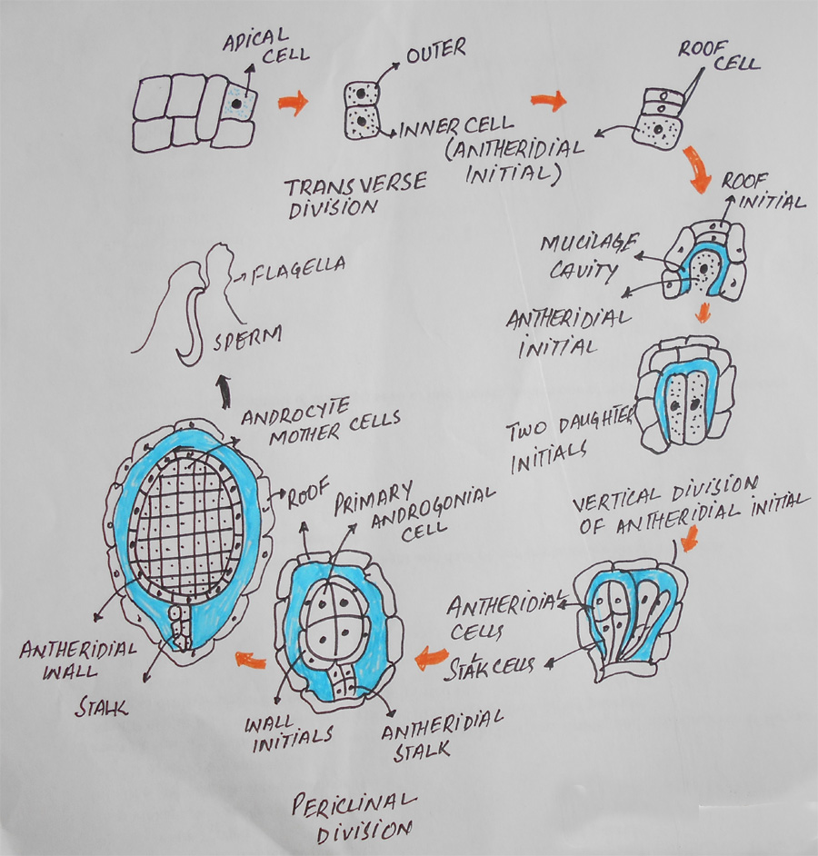

Slide 33
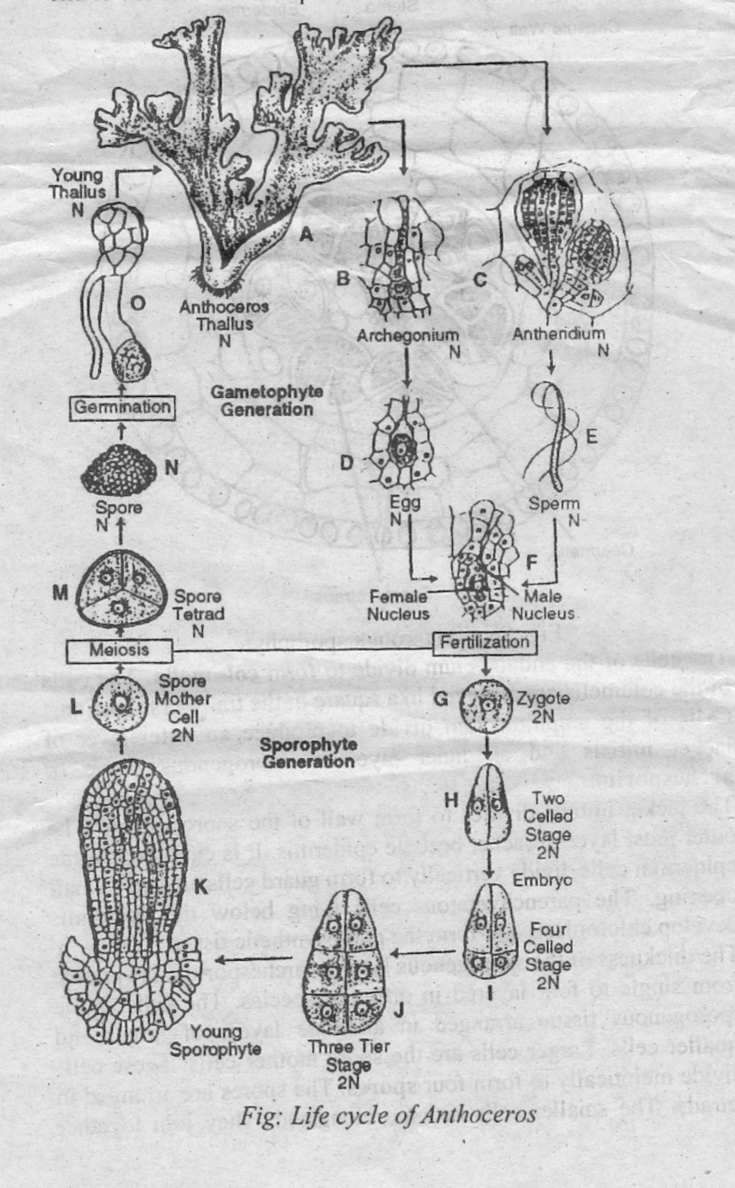

Slide 34
References
Source : https://istudy.pk/anthoceros/
https://www.slideshare.net/pranjaldhaka/anthoceros-ppt
https://www.slideshare.net/jayakar/anthoceros
A textbook of BOTANY, Paper-A---Diversity of Plants by Tanveer Ahmad Malik and Dr. Hammad Ashraf

